Slide 1
S&P500 and US Macroeconomic Data Relationship and Prediction

Slide 2
Project Goal
Extract S&P500 price and US Macroeconomic data from 1981 to 2021
Analyze their relationship, lead-lag dynamics, and prediction power
Highlighting the potential insights and implications for financial forecasting

Slide 3
Data Sources
The data is monthly based:
Composite Leading Indicators Reference Series (GDP) Normalized for United States:
https://fred.stlouisfed.org/series/USALORSGPNOSTSAM
USA Key Economic Indicators:
https://www.kaggle.com/datasets/calven22/usa-key-macroeconomic-indicators
S&P 500 (SPX):
https://www.investing.com/indices/us-spx-500-historical-data

Slide 4
Data Transformation
The transformation is necessary since a lot of the data e.g. CPI, GDP, S&P500 are trending up over time which may result spurious regression
Also the time series models(VAR) and Granger causality assume stationarity, which minimize the chance of Type I errors and enable models to learn stable patterns

Slide 5
Non-Stationary US Macroeconomic Data | Transformation | Stationary US Macroeconomic Data
Price | np.log(df['Price']).diff() | SP500_returns
Personal Consumption Expenditures | np.log(df['Personal Consumption Expenditures']).diff() | Consumption_growth
Real Disposable Personal Income | np.log(df['Real Disposable Personal Income']).diff() | Income_growth
Personal Saving Rate | np.log(df['Personal Saving Rate']).diff() | Personal_Saving_Rate
M2 | df['M2'].pct_change() | M2_pct_change
Industrial Production Index | np.log(df['Industrial Production Index']).diff() | IP_growth
Total Construction Spending | np.log(df['Total Construction Spending']).diff() | Construction_growth
Real Broad Exchange Rate | np.log(df['Real Broad Exchange Rate']).diff() | FX_returns
10-Year Yield | df['10-Year Yield'].diff() | 10Y_yield_diff
Federal Funds Rate | df['Federal Funds Rate'].diff() | FFR_diff
CPI | np.where( df.index.year < 1990, df['CPI'].pct_change(1), df['CPI'].pct_change(2) | CPI_adj
CPI | np.log(df['CPI']).diff(12).diff(1) | D1_D12_log_CPI
Normalized GDP |  | Normalized GDP

Slide 6
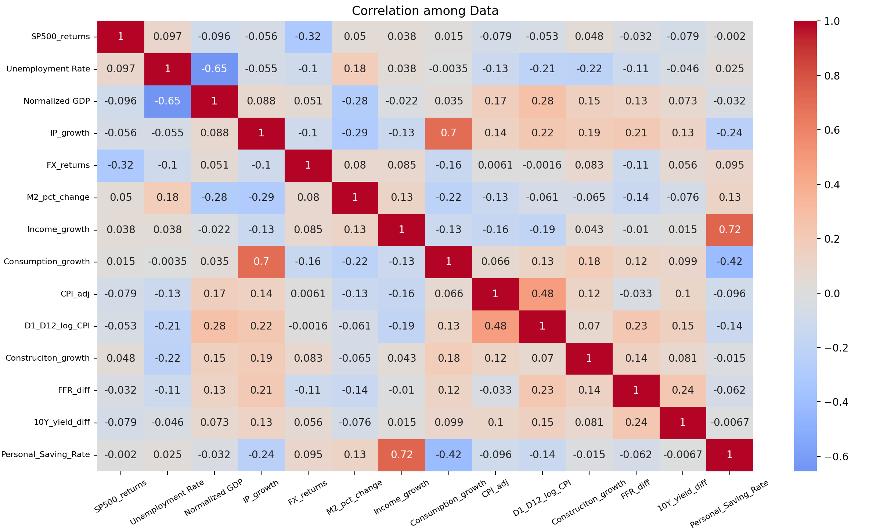
Correlation of Data From Jan 1981 to Oct 2021

Slide 7
Pearson Correlation - Summary
Target = SP500_returns
Summary: SP500_returns shows no significant correlation with any of the US Macroeconomic Data after transformation from non-stationary to stationary.
Implication: Traditional linear models (e.g., regression) may not capture these relationships effectively. Non-linear or lagged effects dominate

Slide 8
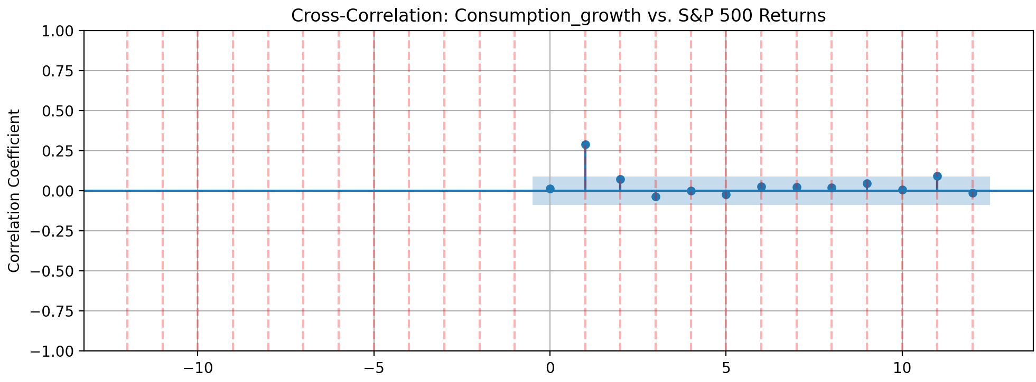
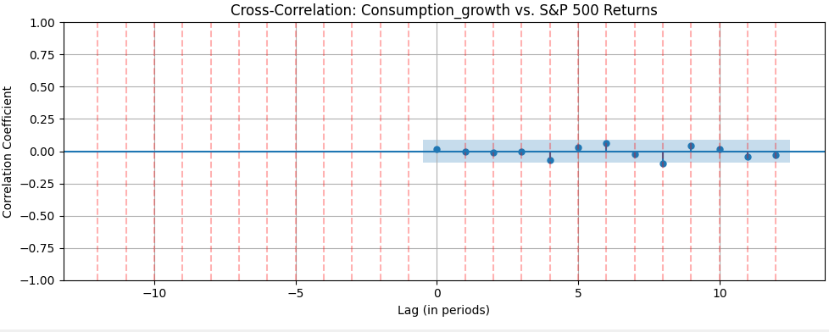
Cross-Correlation Function
Macro -> S&P500
S&P500 -> Macro

Slide 9
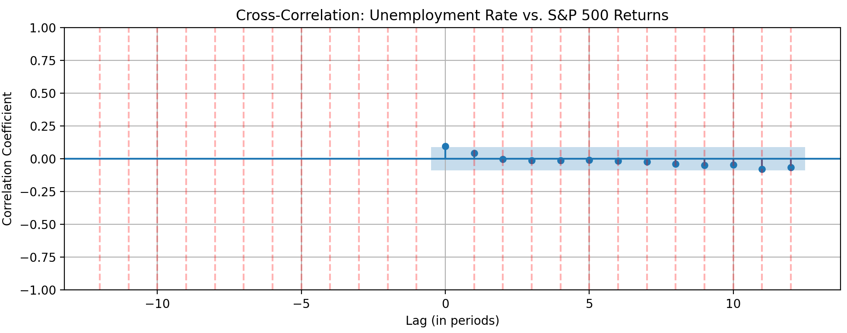
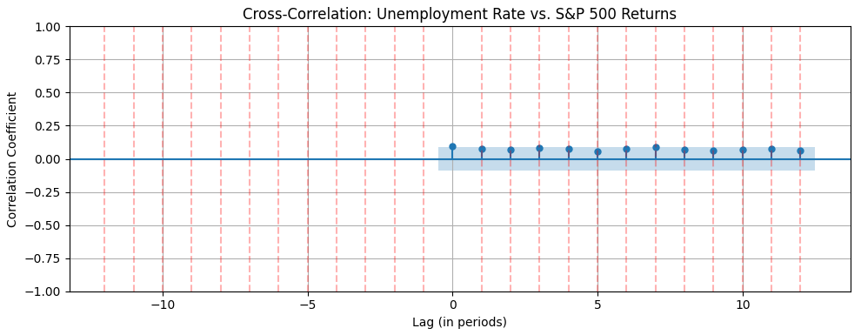
Macro -> S&P500
S&P500 -> Macro

Slide 10
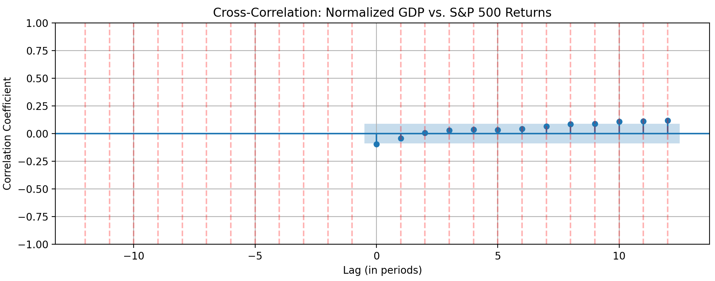
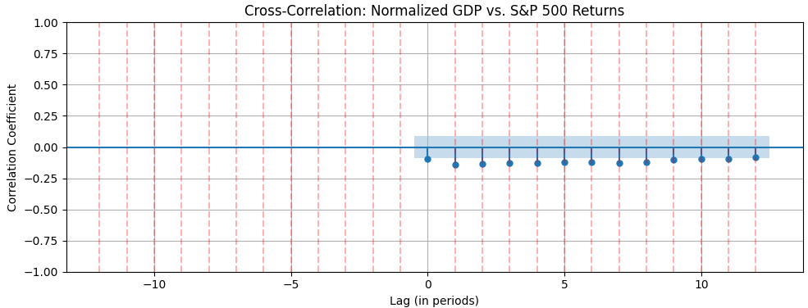
Macro -> S&P500
S&P500 -> Macro

Slide 11
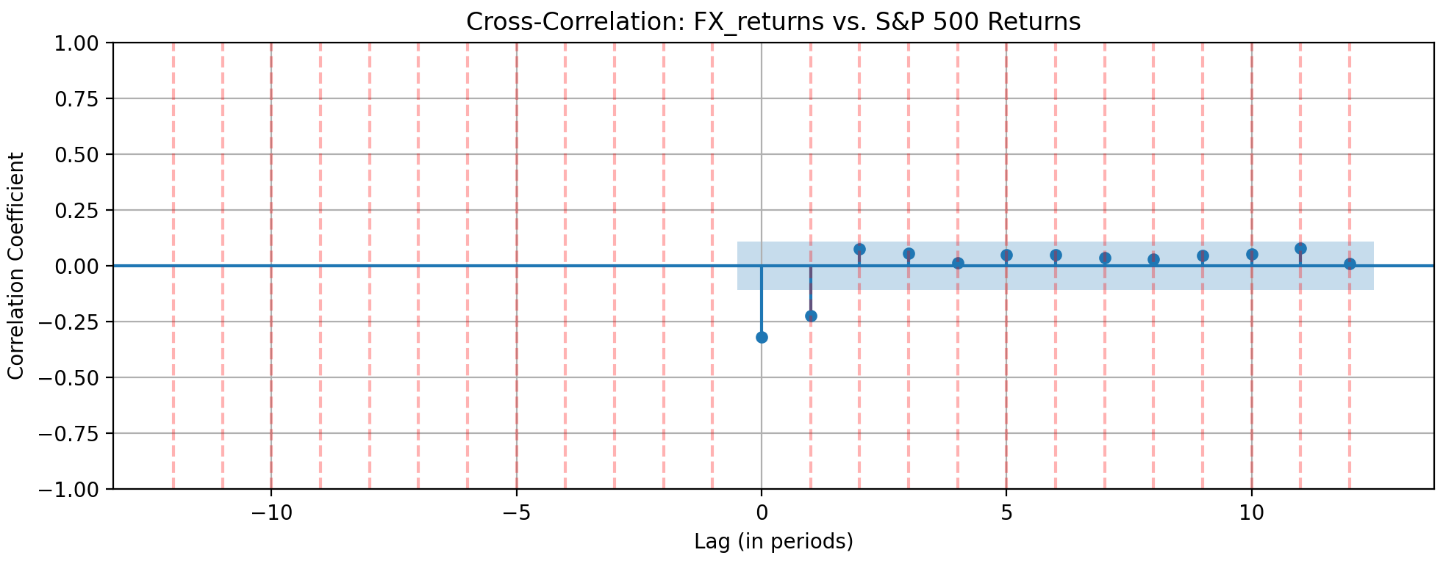
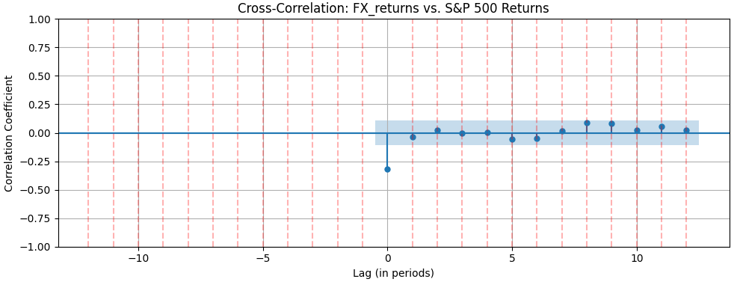
Macro -> S&P500
S&P500 -> Macro

Slide 12
Cross-Correlation Function - Summary
Only shown four of the results, since all of them(even switching orders) show the same problem:
Cross-Correlation Function (CCF) results show no significant negative lags in either variable order, this suggests
The two variables move independently in time. Neither leads nor lags the other in a statistically meaningful way
The variables move together contemporaneously (at lag 0), but neither leads the other

Slide 13
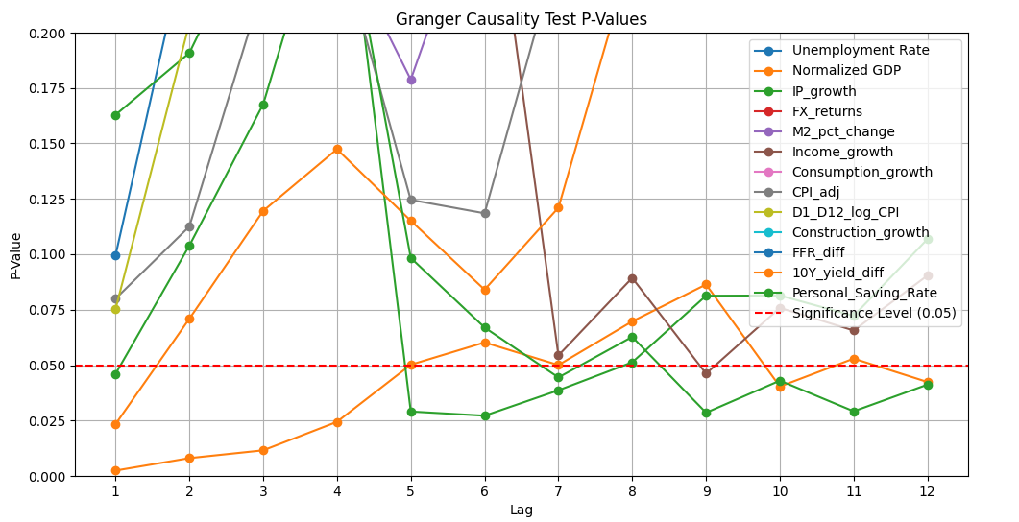
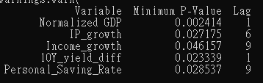
variables Predict SP500_returns
Normalized GDP

Slide 14
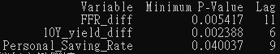
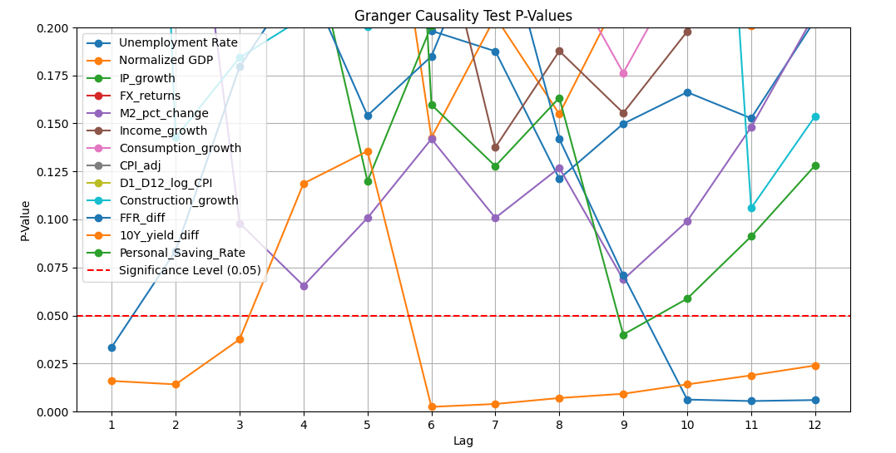
variables Predict SP500_returns (Non-recession)
Unemployment Rate

Slide 15
Granger Causality: Macro → S&P 500
Non-Recession Periods:
Only interest rates (10Y yield) and saving rates matter, at shorter lags (1–9 months).
Interpretation: Monetary policy and consumer behavior dominate in stable markets.

Slide 16
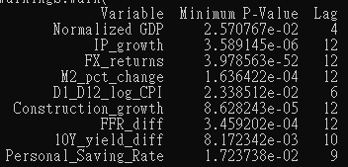
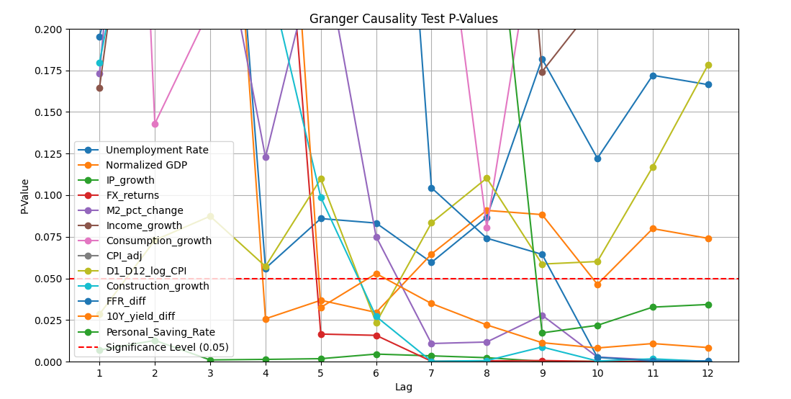
variables Predict SP500_returns (Recession)
Unemployment Rate

Slide 17
Granger Causality: Macro → S&P 500
Recession Periods:
GDP, industrial production (IP), income growth, and monetary policy variables (Fed funds, M2, 10Y yield) Granger-cause S&P 500 returns at long lags (6–12 months)
Interpretation: Macro fundamentals drive market returns during crises, but with delayed effects
Contradiction with Granger Causality: S&P 500 → Macro Variables in recession period (explain later in that slide)

Slide 18
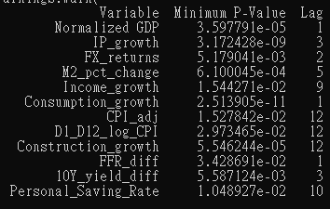
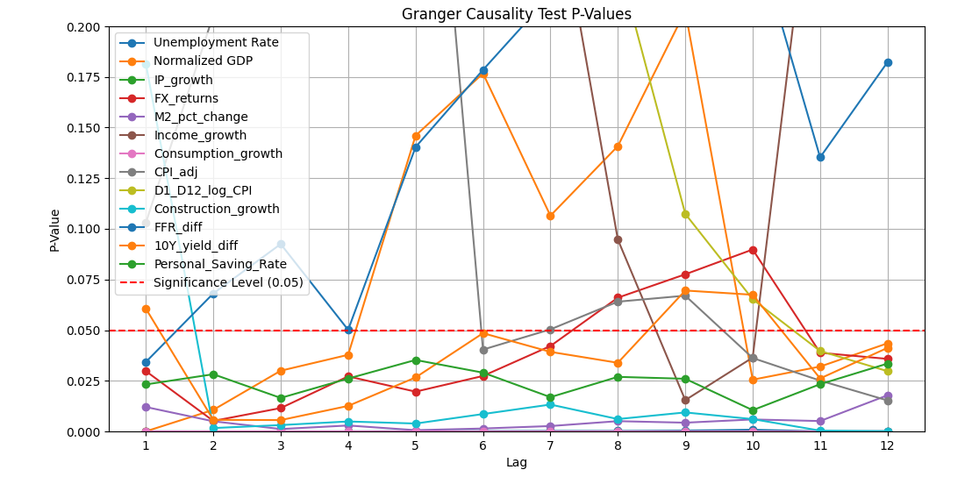
SP500_returns Predict variables

Slide 19
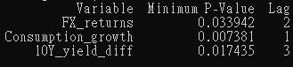
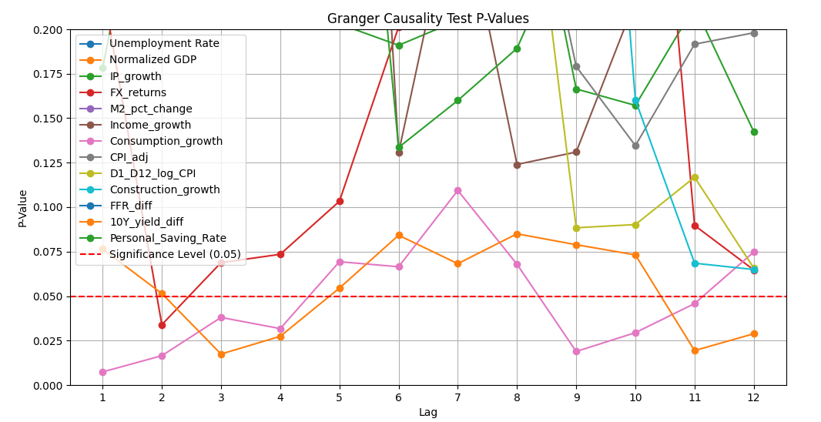
SP500_returns Predict variables (Non-Recession)

Slide 20
Granger Causality: S&P 500 → Macro Variables
Non-recession Periods:
Interpretation:
S&P 500 Returns → FX Returns (Lag 2): It might indicate that investor sentiment in equity markets impacts currency markets after a short delay.
S&P 500 Returns → Consumption Growth (Lag 1): This suggests that positive stock market performance may lead to increased consumer confidence and spending right away.
S&P 500 Returns → 10-Year Yield (Lag 3): This might reflect how equity market performance influences interest rates over a longer time frame, potentially through expectations about economic growth and inflation

Slide 21
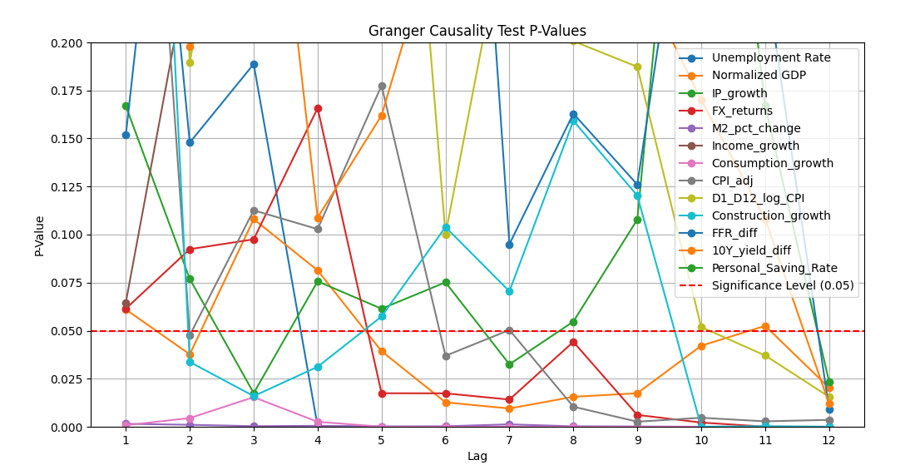
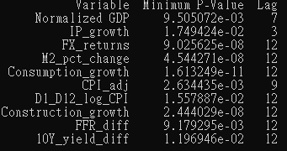
SP500_returns Predict variables (Recession)
Unemployment Rate

Slide 22
Granger Causality: S&P 500 → Macro Variables
Recession Periods:
Market movements predict 12-month lags in macro variables (e.g., GDP, CPI, construction growth)
Interpretation: Markets anticipate economic shifts, especially during downturns, markets react earlier (6-12 months) than the macro variables
Contradiction with Granger Causality: Macro Variables → S&P 500 in recession period
Feedback Loops:
There might be complex feedback loops where S&P 500 returns influence economic indicators (like consumer sentiment and spending) while simultaneously being influenced by those indicators.
In recession periods, the interplay can lead to mutual influences that complicate the direction and timing of effects
Statistical Properties:
The presence of multicollinearity among predictors during recessions may affect the significance of p-values and the ability to identify clear causal paths.
Changes in volatility during recessions can impact the stability of relationships, leading to differing predictive results

Slide 23
Granger Causality - var Predict SP500_returns
Tests: Do macro variables predict SP500?
Significant Variables (p < 0.05) | p-value | Interpretation
Normalized GDP | 0.0024 (**) | GDP growth predicts future SP500 returns
IP_growth | 0.0276 (*) | Industrial production weakly predicts market returns
10Y_yield_diff | 0.0233 (*) | Yield changes help forecast SP500 performance

Slide 24
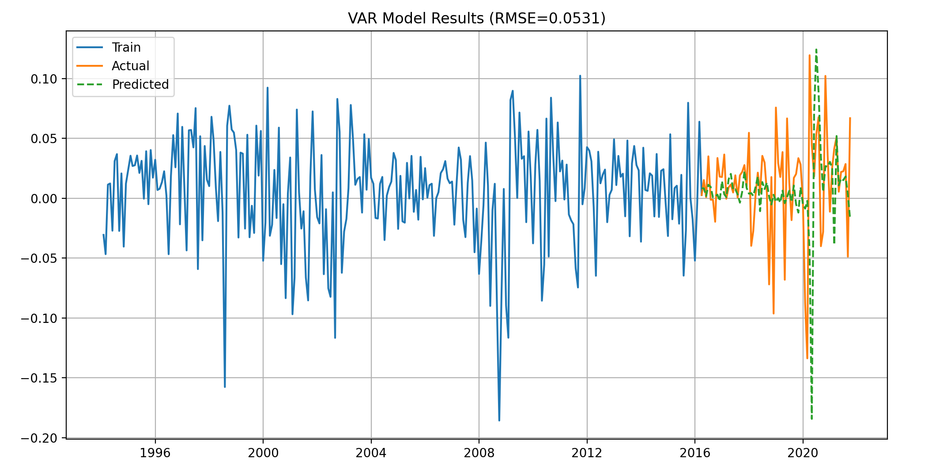
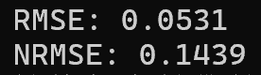
Selection of Data for VAR Models
Normalized GDP,
IP_growth,
10Y_yield_diff

Slide 25
Granger Causality - SP500_returns Predict var
Tests: Does SP500 predict macro variables?
Significant Variables (p < 0.05) | p-value | Interpretation
Normalized GDP | 3.60e-05 (***) | SP500 strongly predicts future GDP (market leads economy)
IP_growth | 3.17e-09 (***) | Stock market movements predict industrial production
10Y_yield_diff | 0.0036 (**) | Market returns predict yield curve movements
Consumption_growth | 2.51e-11 (***) | SP500 returns anticipate future consumption change

Slide 26
Insight
Bi-Directional Relationships
GDP
Industrial
Produciton
10Y Yield
SP500

Slide 27
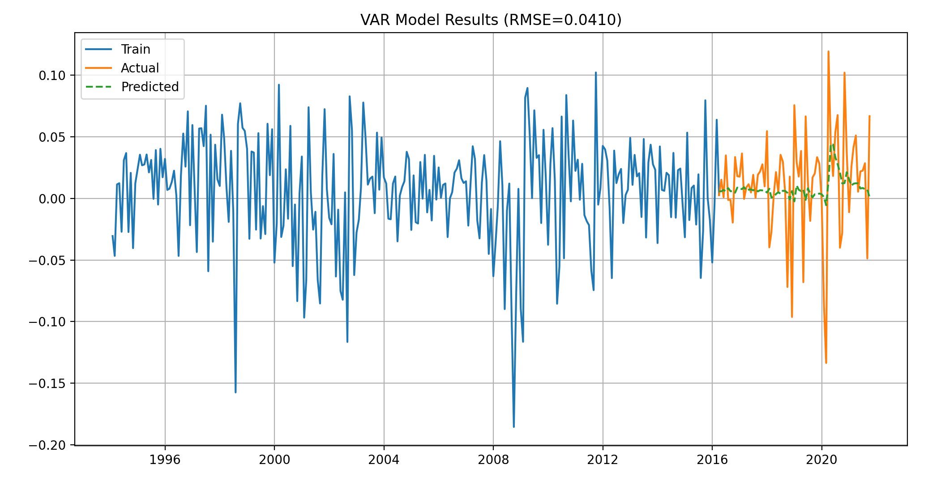
Other Selection of Data for VAR Models
Normalized GDP,
Unemployment Rate,
10Y_yield_diff

Slide 28
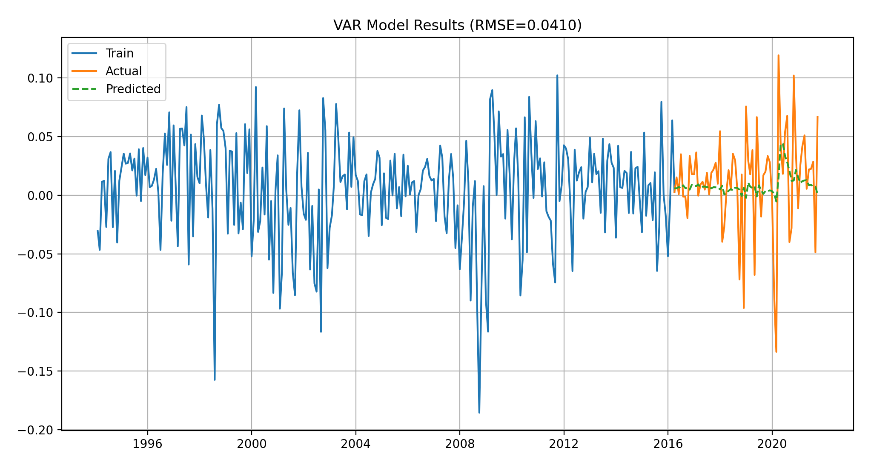
Other Selection of Data for VAR Models
Normalized GDP,
D1_D12_log_CPI,
10Y_yield_diff

Slide 29
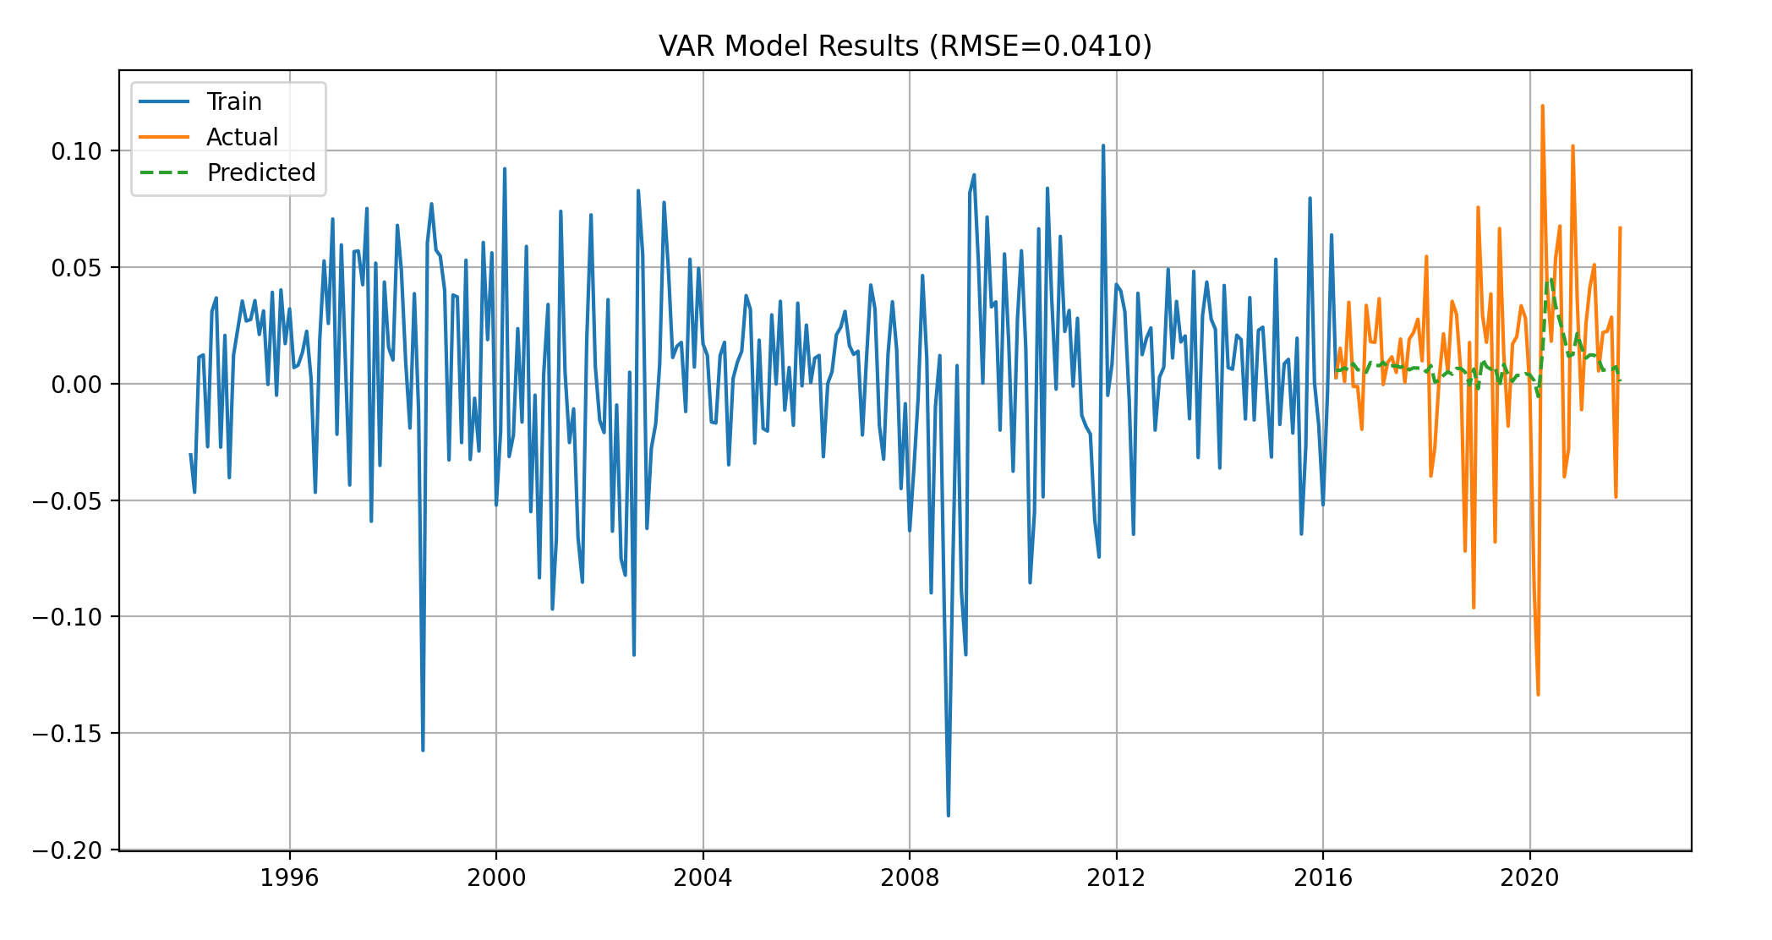
Other Selection of Data for VAR Models
Normalized GDP,
CPI_adj,
10Y_yield_diff

Slide 30
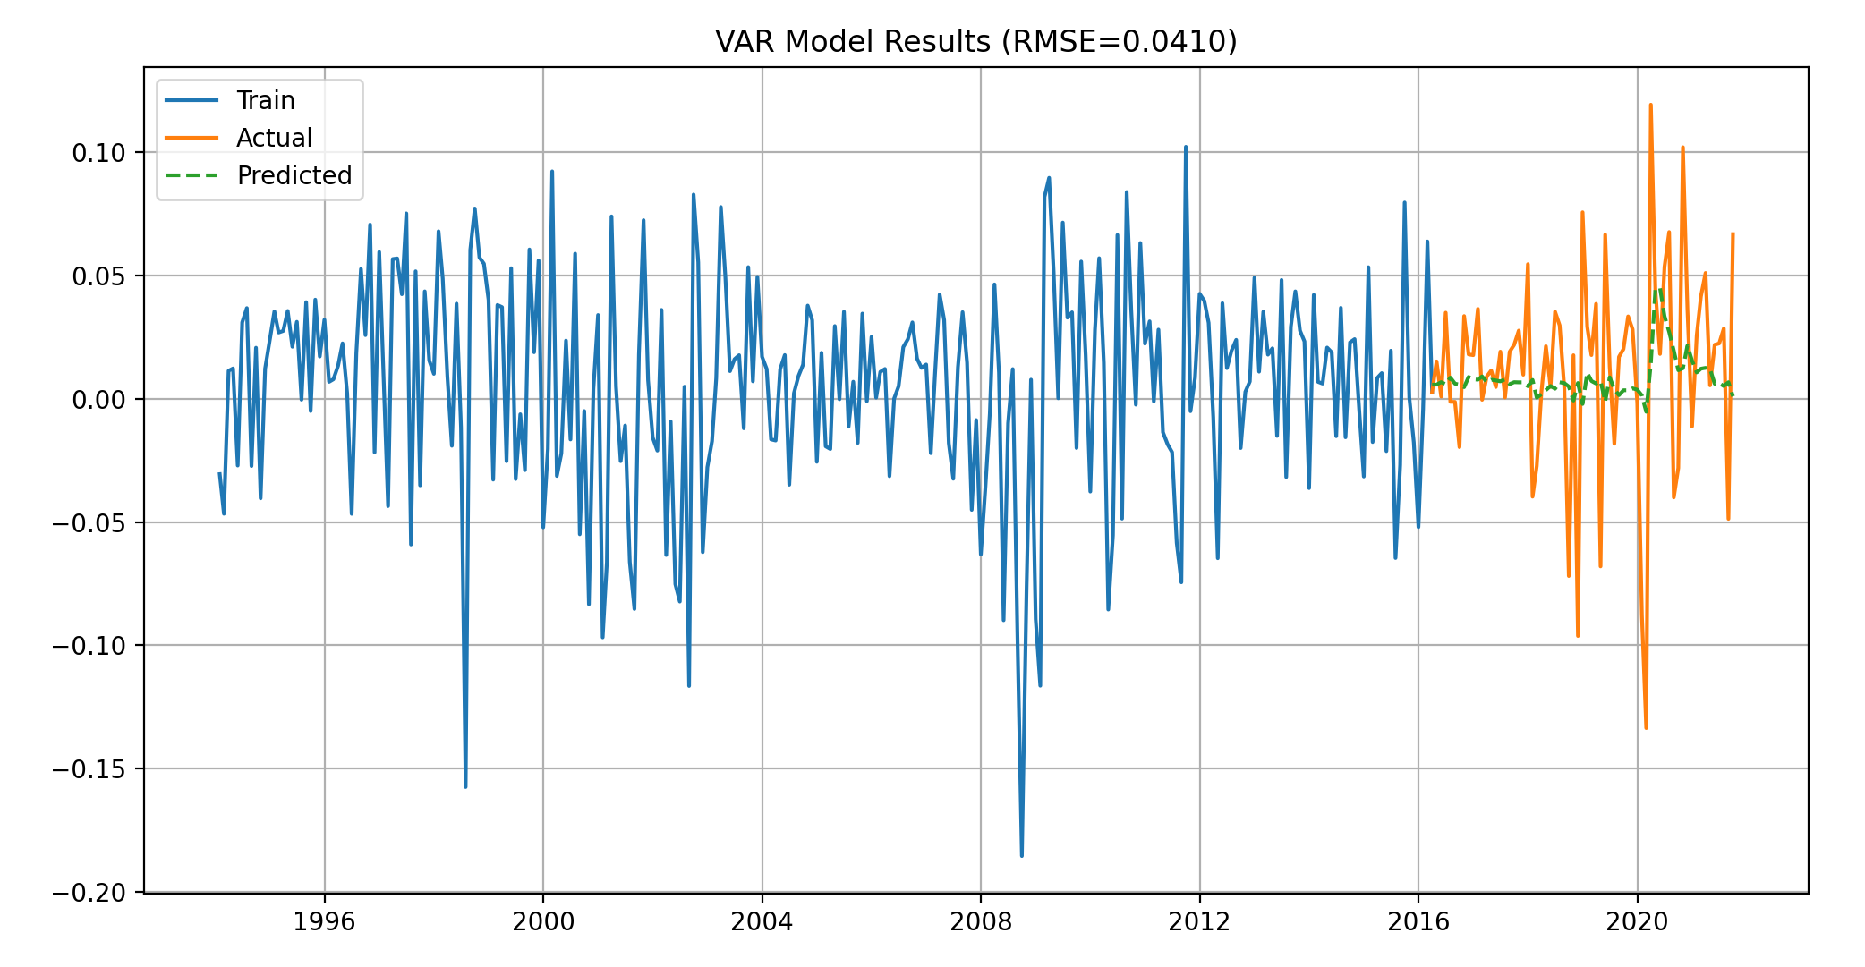
Other Selection of Data for VAR Models
Normalized GDP,
CPI_adj,
D1_D12_log_CPI

Slide 31
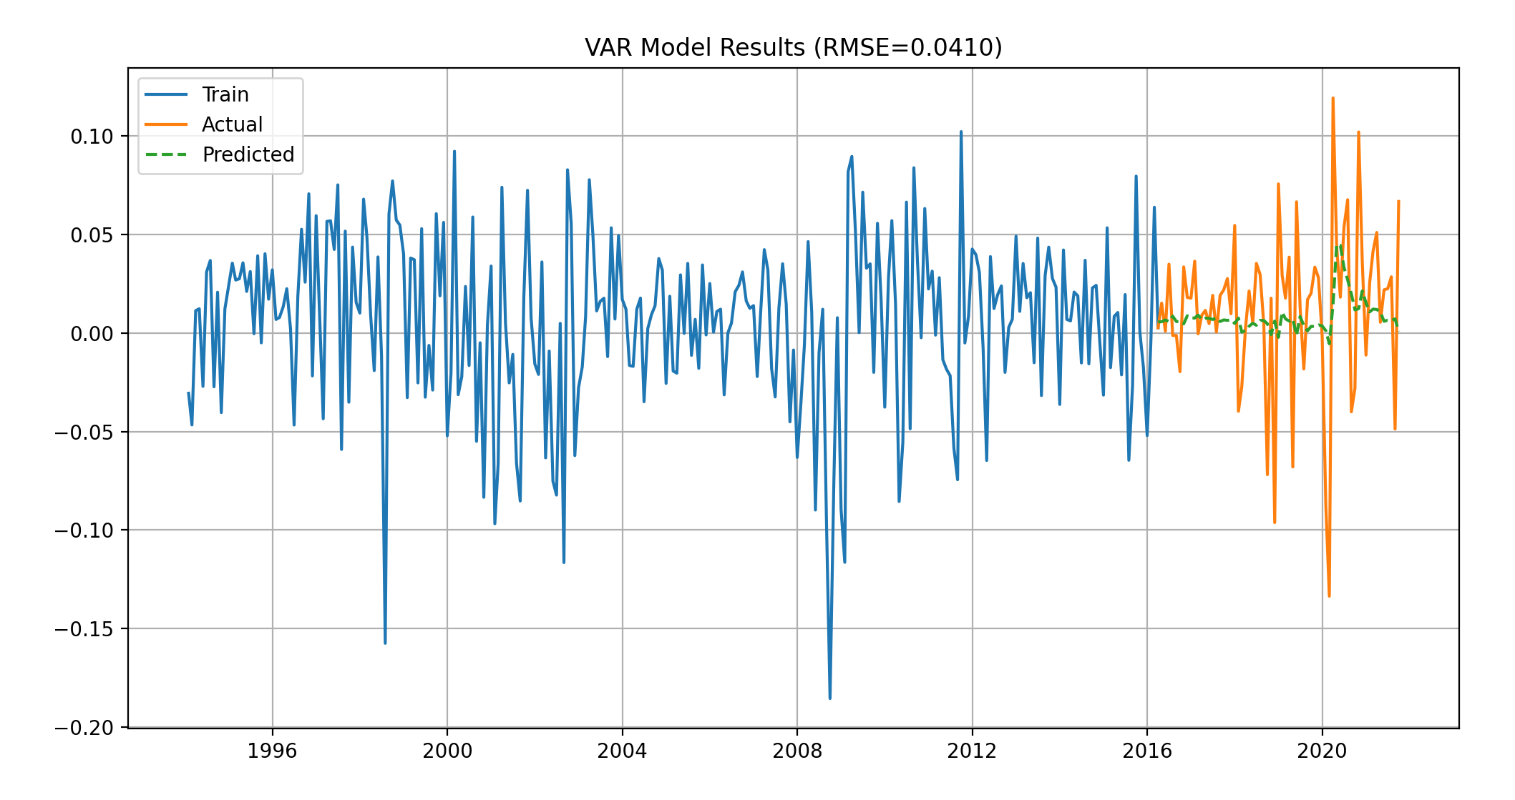
Other Selection of Data for VAR Models
Normalized GDP,
Unemployment Rate,
CPI_adj

Slide 32
VAR Models - Summary
Combincation of Normalized GDP, Unemployment Rate,10Y_yield_diff can do better predtiction with lower error RMSE, 0.041
Comparing the three variables Normalized GDP, IP_growth, 10Y_yield_diff selected from the Granger Casusality Test regradless recession which predict SP500 returns with RMSE 0.0531
Combo of three of the variables: Normalized GDP, D1_D12_log_CPI, and 10Y_yield_diff among all variables make the best prediction for SP500 Return in VAR model
Adding variable into the models does not improve the prediction shown as below table:
Combination | RMSE | NRMSE
Normalized GDP, D1_D12_log_CPI, 10Y_yield_diff | 0.04099 | 0.13439
Normalized GDP, CPI_adj, 10Y_yield_diff | 0.04099 | 0.13440
Normalized GDP, CPI_adj, D1_D12_log_CPI | 0.04100 | 0.13441
Normalized GDP, Unemployment Rate, CPI_adj | 0.04101 | 0.13444
Normalized GDP, CPI_adj, D1_D12_log_CPI, 10Y_yield_diff | 0.04101 | 0.13444
Unemployment Rate, Normalized GDP, CPI_adj, D1_D12_log_CPI | 0.04101 | 0.13444
Unemployment Rate, Normalized GDP, CPI_adj, 10Y_yield_diff | 0.04101 | 0.13446
Unemployment Rate, Normalized GDP, D1_D12_log_CPI, 10Y_yield_diff | 0.04102 | 0.13449

Slide 33
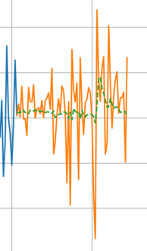
Prediction vs Actual plot
The discrepancy between a seemingly good RMSE (< 0.05) and visibly poor alignment in prediction vs. actual plot :
1.Scale Interpretation
SP500_returns fluctuate between -24.5% and +12.3% monthl , an RMSE of 0.04 means predictions are off by 4 percentage points on average - substantial for financial data, but a 4% error in predicting daily S&P 500 returns would make the model practically unusable for trading

Slide 34
Prediction vs Actual plot
2. Key Reasons for Visual Mismatch
A. Cumulative Error Effect
Even small errors compound over time in autoregressive models
Plot likely shows multi-step predictions, where each forecasted value uses previous predictions (not ground truth). This propagates errors
B. Phase Lag
VAR models often "lag" the true series by 1-2 periods, especially if:
The true series has momentum not captured by your features
The model is underspecified (e.g., missing critical variables)
C. Volatility Mismatch
Your model might predict the direction reasonably well but fail to capture:
Magnitude of large moves (e.g., crashes/ rallies)
High-frequency volatility
D. Nonlinearity Ignored
VAR is a linear model - it cannot capture:
Threshold effects (e.g., panic selling when returns cross -5%)
Regime shifts (e.g., high vs. low volatility environments)

Slide 35
Improvement Strategies
A.Include volatility proxies: VIX, realized volatility
B. Feature Engineering
Nonlinear terms: Rolling max/min, sign changes.
Interaction terms: E.g., M2_growth * Inflation.
C. Alternative Models
Markov-Switching VAR: For regime-dependent behavior.
LSTM/VAR Hybrid: Combine VAR with neural nets for nonlinear patterns.

Slide 36
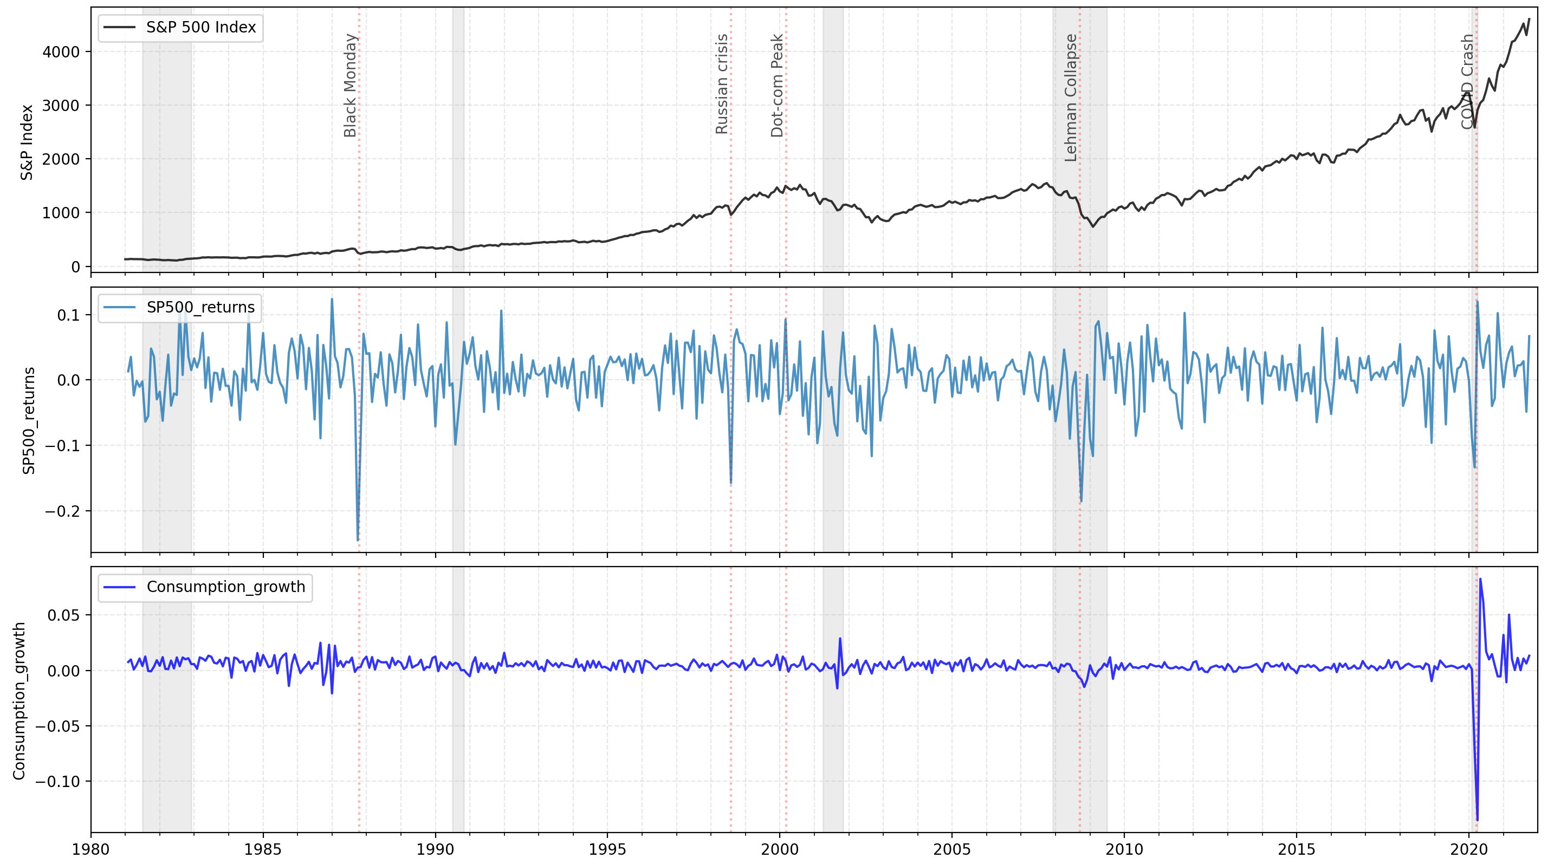
Visual Inpestion of Data

Slide 37
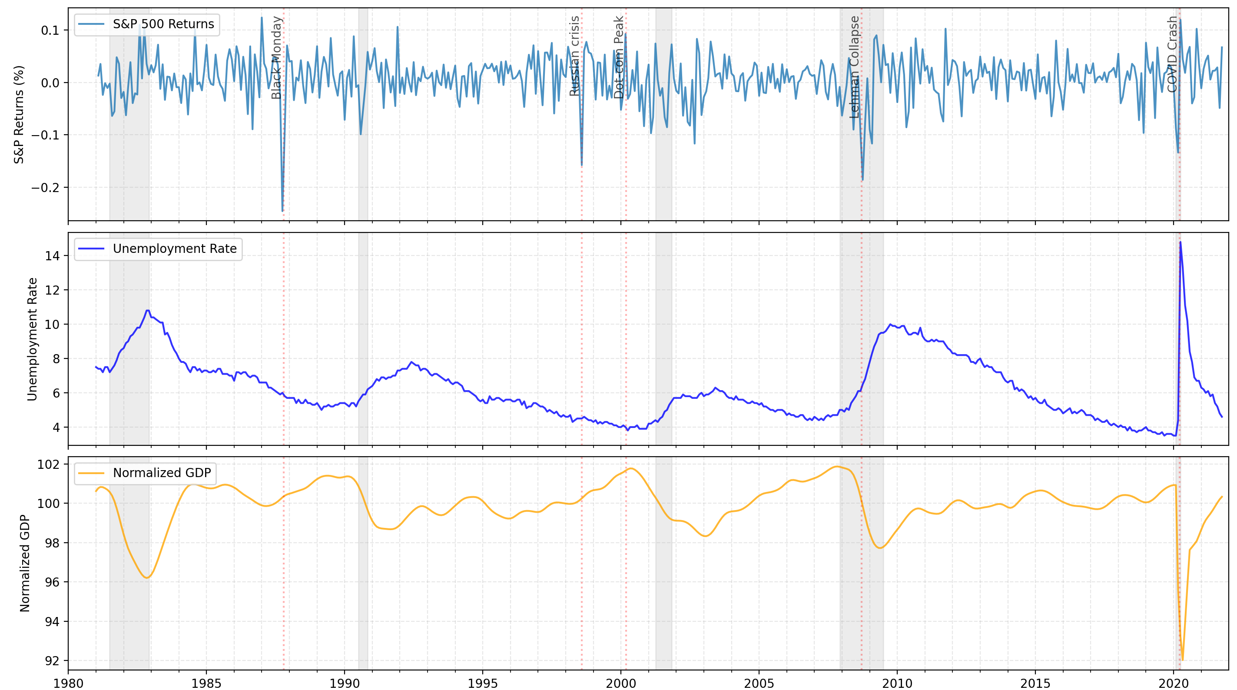

Slide 38
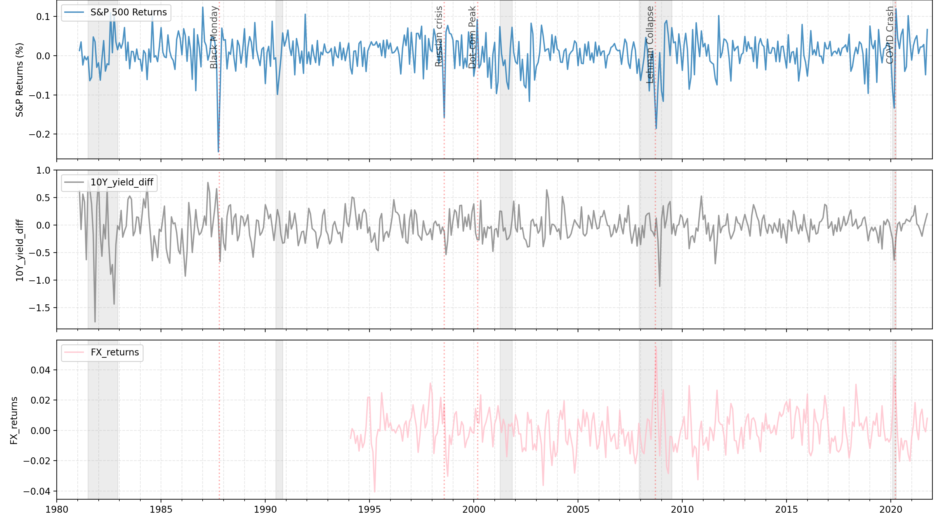

Slide 39
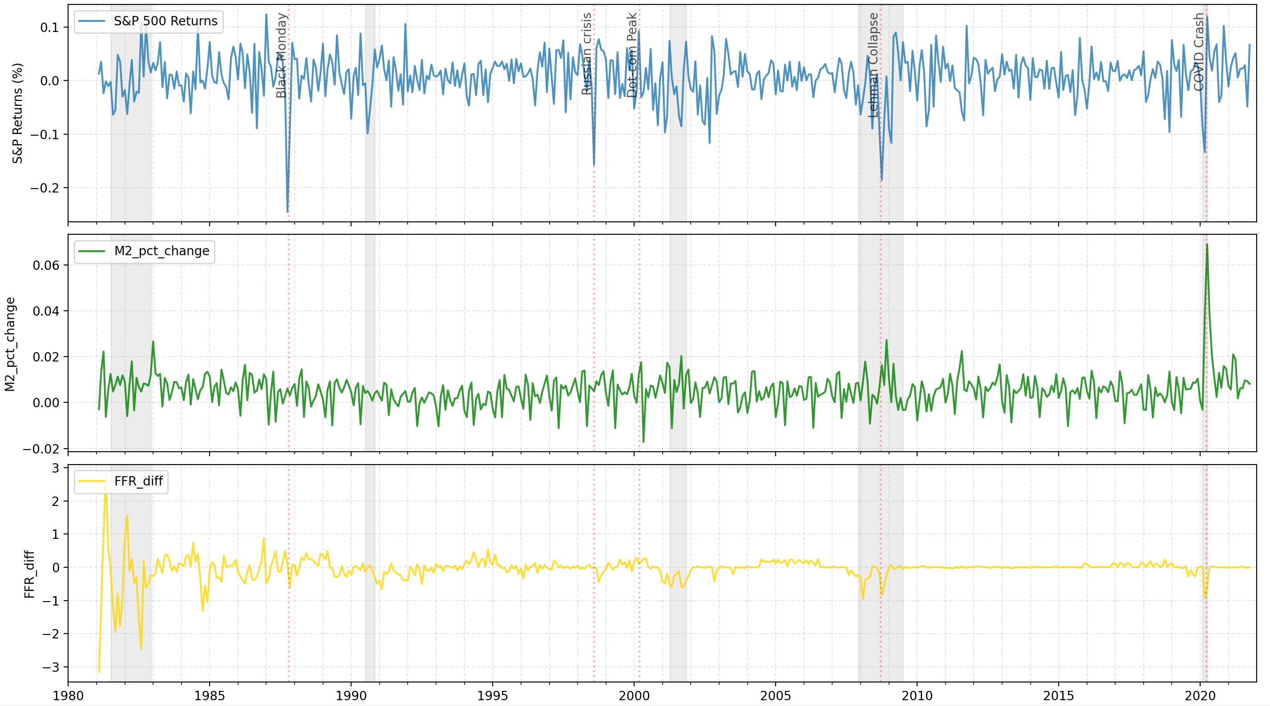

Slide 40
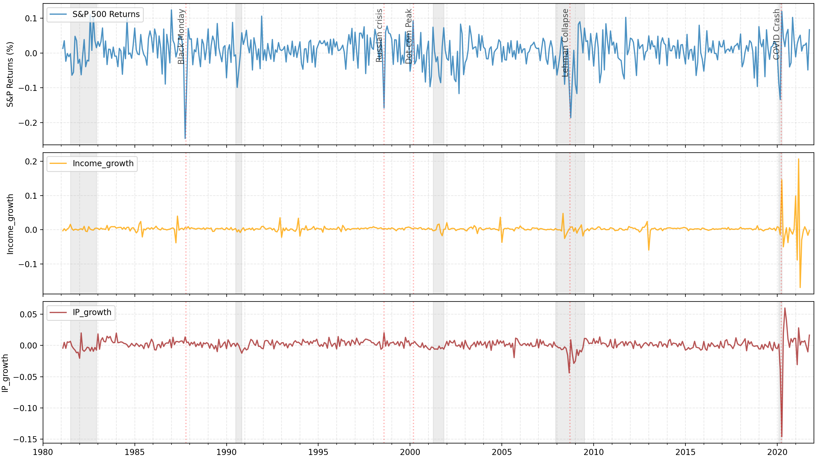

Slide 41
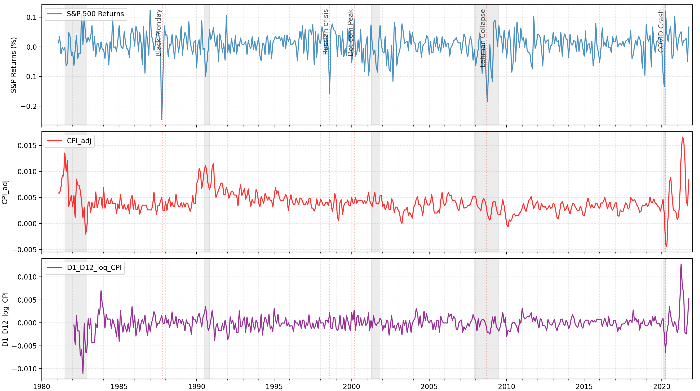

Slide 42
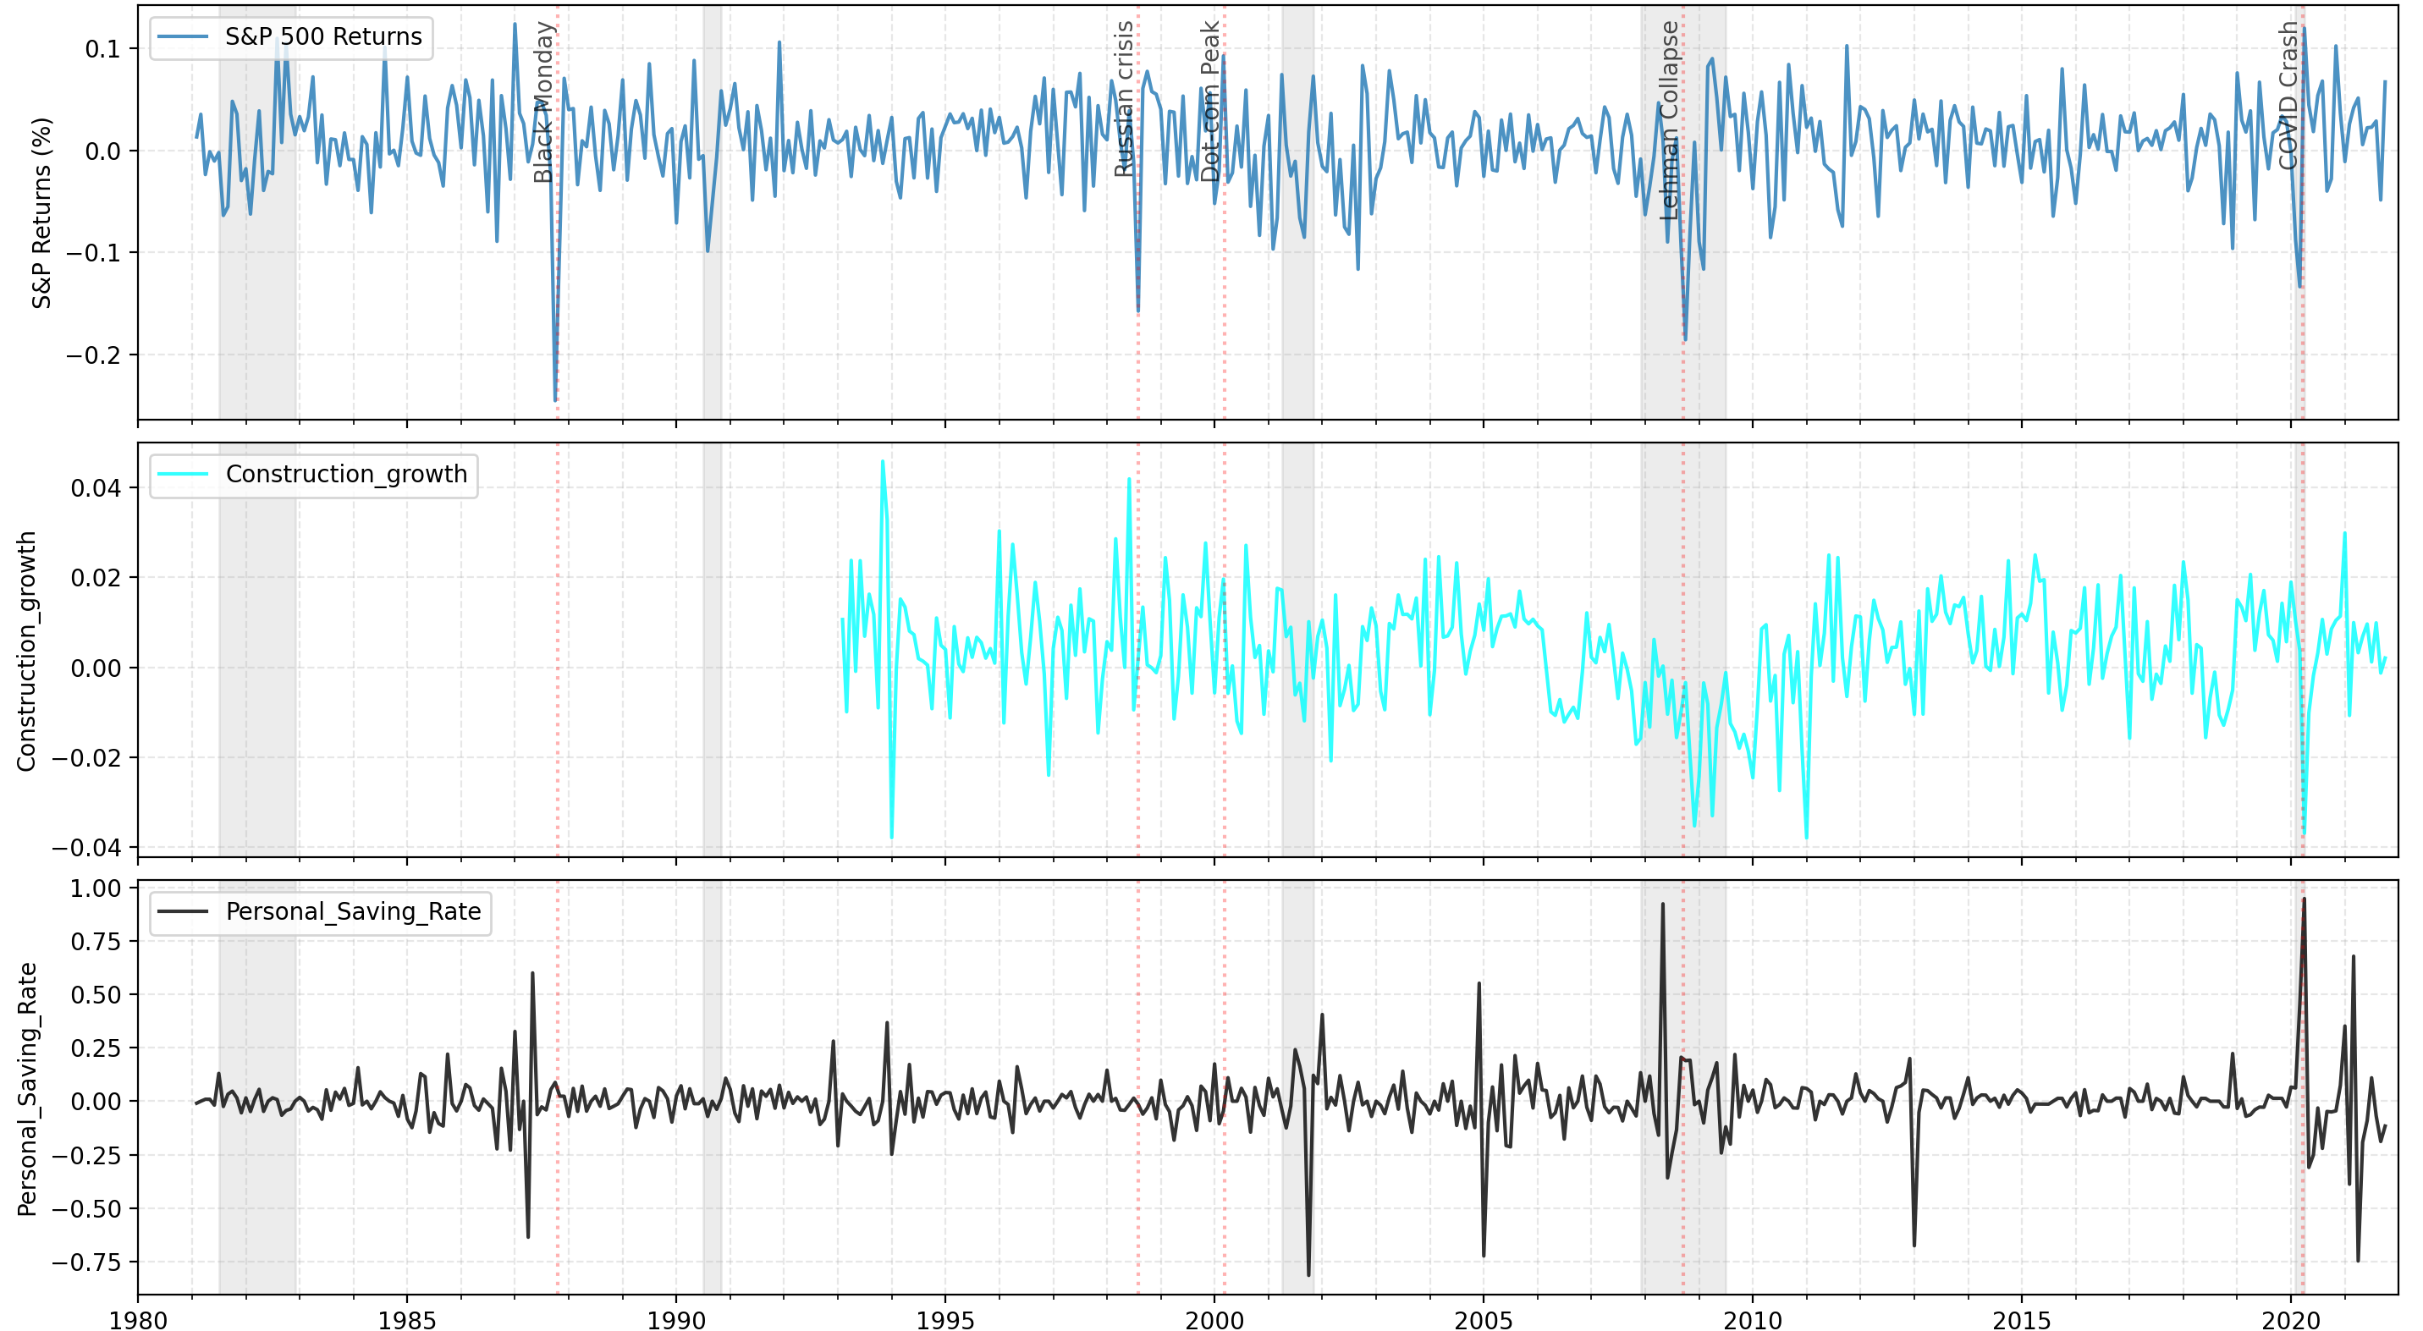

Slide 43
Conclusion
Correlation heatmap and Cross-Correlation Function (CCF) test:
The macroeconomic variable does not have a strong linear relationship with S&P 500 returns
Granger Causality:
However, it may still contain predictive information (Granger causality) in a way that is not captured by simple correlation
Tests whether past values of one variable help predict another beyond what is explained by its own past. It does not require a strong contemporaneous correlation
Even if there is no strong linear correlation, macroeconomic variables might still have nonlinear or indirect predictive power for stock returns
Example: Certain macroeconomic shocks (e.g., Fed policy changes) may not immediately impact returns but could have delayed effects captured by Granger causality
Granger causality is sensitive to lagged predictive relationships, whereas CCF only measures linear dependence at specific lags

Slide 44
THANKS

